Slide 1

Grammar & Basics
Adverb vs Adjectives

Slide 2
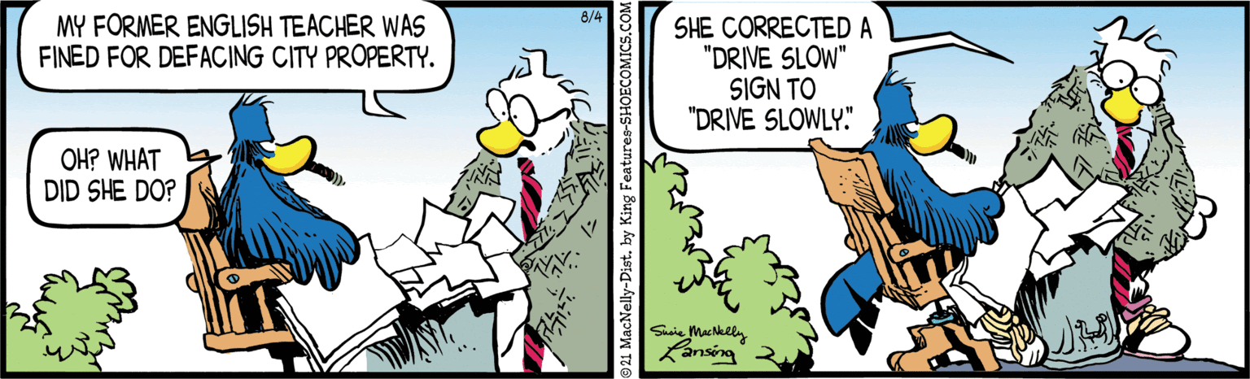

Slide 3
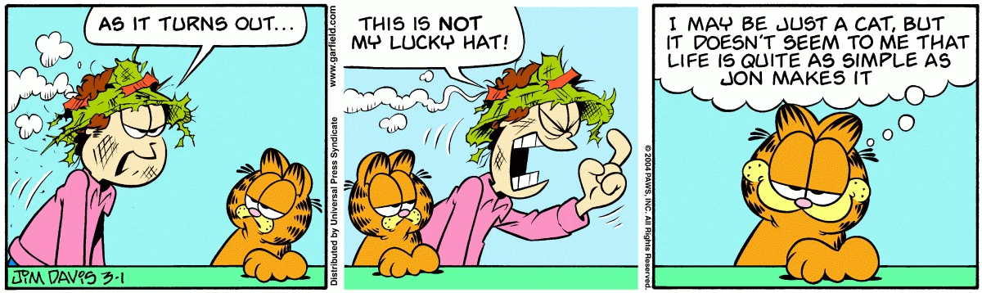

Slide 4
Adjectives vs. Adverbs
Adjectives
Adverbs
Modify nouns and pronouns
e.g. beautiful, cool, wonderful, smooth, expensive
Modify the rest (adjectives, adverbs, verbs)
e.g. practically, relatively, carefully, naturally, never

Slide 5
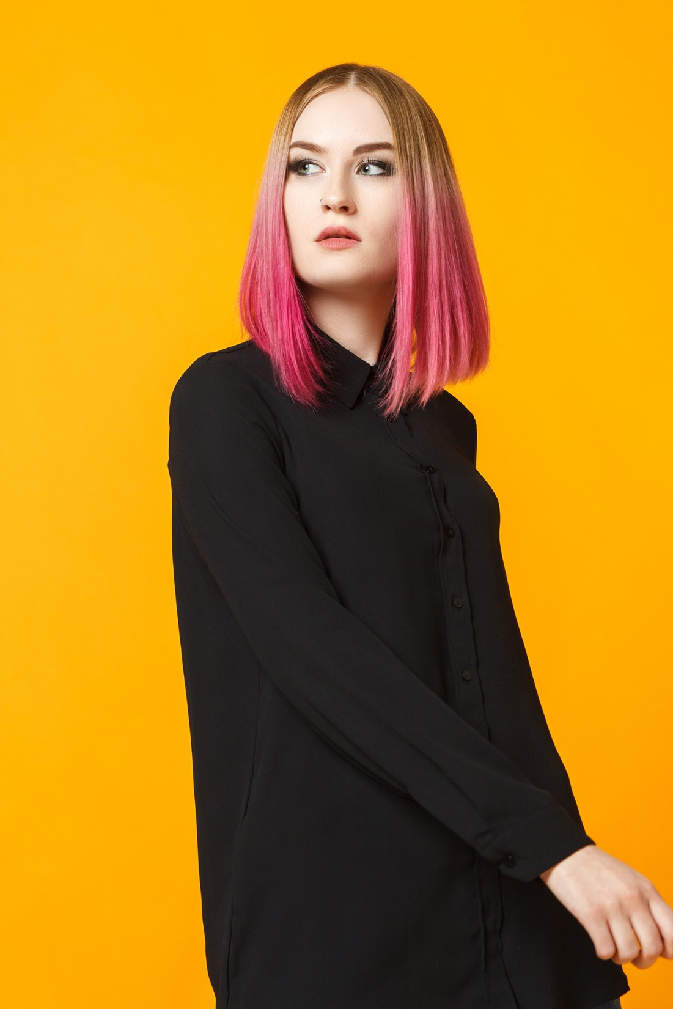
Adjectives

Slide 6
Adjectives
Modify nouns and pronouns only
Can be used in two main ways
A young woman
The woman is young
Only the second one is possible with pronouns
She is young

Slide 7
Two Ways of Using Adjectives
in front of noun | after linking verb

Slide 8
Two Ways of Using Adjectives
in front of noun | after linking verb
 | be, become, seem, feel, taste, etc.

Slide 9
Two Ways of Using Adjectives
in front of noun | after linking verb
 | be, become, seem, feel, taste, etc.
a great show A persevering student

Slide 10
Two Ways of Using Adjectives
in front of noun | after linking verb
 | be, become, seem, feel, taste, etc.
a great show a persevering student An unhappy marriage

Slide 11
Two Ways of Using Adjectives
in front of noun | after linking verb
 | be, become, seem, feel, taste, etc.
a great show a persevering student an unhappy marriage | the pizza tastes great the student is persevering He feels unhappy

Slide 12
One position
Only in front of a noun
The only thing we can do is wait.
The former prime minister is giving a lecture.
Only after a linking verb
Careful, the dog is asleep.
Linda felt ill last week.

Slide 13
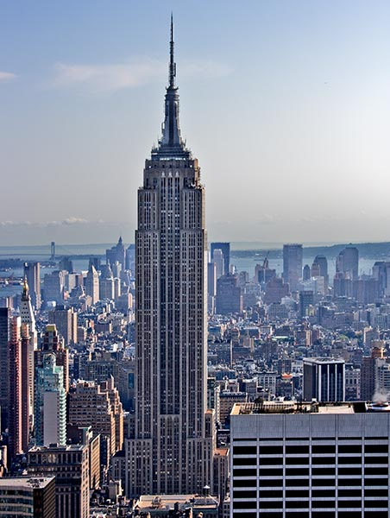
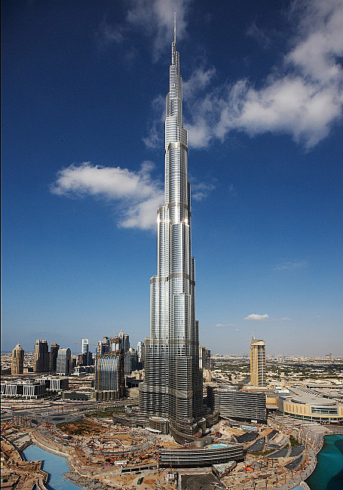
Comparison

Slide 14
Comparison
Comparative:
That tower is taller than most other towers.
Superlative:
But this tower is the tallest.

Slide 15
Comparison
Rules
1 syllable → -er and –est She is bigger than her brother. She is the biggest.
2 syllables→ -er and -est or more/most He is funnier than his sister His uncle is the funniest She is more famous than you They are the most famous
3+ syllables → more and most They are more beautiful than her She is the most beautiful

Slide 16
Some spelling rules
Words that end in -e →-r, -st
wider, later, larger
Words ending in vowel + consonant (big, wet, thin) double the consonant →
bigger, wetter, thinner
Words ending in -y → -ier, iest
easier, heavier, luckier

Slide 17
Comparison – Two syllables
- er and - est
She is funnier than her brother.
OR more and most
She is more famous than her brother.

Slide 18
Comparison – Two syllables
le | simple – simpler – simplest
er | clever – cleverer – cleverest
y | happy – happier – happiest
ow | yellow – yellower – yellowest
-some | handsome – handsomer - handsomest

Slide 19
Comparison – Three syllables
more and most
She is more intelligent than her brother.
She is the most intelligent.

Slide 20
Irregular Forms
Bad – worse – worst
Far – farther – farthest
Far – further – furthest
Good – better – best
Little – less – least
Many – more – most
Much – more – most
Old – older – oldest
Old – elder – eldest
Notes:
Far farther farthest → distance only
Far further furthest → distance and addition
Older elder eldest → only before these nouns: son, daughter, brother, sister, child

Slide 21
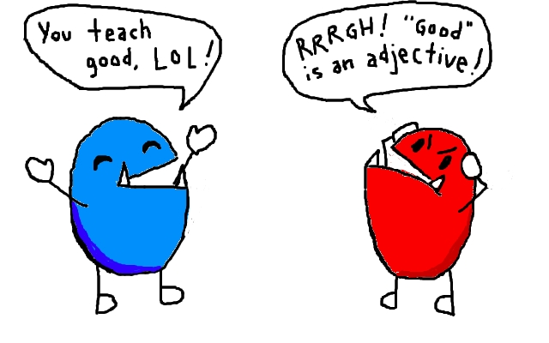
Adverbs

Slide 22
Adverbs Modify...
Type | Example
Verbs | hanging dangerously over
Adjectives | very beautiful faces
Other adverbs | never carefully considers
Phrases | nearly to the edge of the cliff, she was practically crying her eyes out
Clauses | just when we arrived
Sentences | fortunately, she is employed

Slide 23
Adverbs Form
adding –ly to base of adjective
He is a careful man.
He drove carefully.
Let’s have a quick look.
He left the room quickly.

Slide 24
Some spelling rules
Words ending in -y → -ily
Easily, heavily, temporarily
Words ending in -le: -le → -ly
Possibly, terribly, simply
Words ending in -ic → -ically
Technically, dramatically, comically

Slide 25
Adverbs Form
Some adverbs same as the adjective
early, late, straight, direct, hard, etc.
I’m going to have an early night.
He left early to get to class in time.
It’s hard to draw a straight line.
We went straight home after the show.

Slide 26
Adverbs Form
Some adverbs mean something else if you add -ly
She worked very hard.
She hardly worked.
He is working late tonight.
Have you seen him lately.

Slide 27
Adverbs form
One adjective has a completely different from as its adverb
That was a good show
They played very well.

Slide 28
Adverbs Form
Some forms are awkward
*difficultly = with great difficulty
Some adjectives already end in –ly
*friendlily = in a friendly way

Slide 29
Adverbs Form
Many adverbs not based on adjectives
I’m leaving soon.
Theo rather likes brownies.
She is very pretty.
I don’t quite see your point.

Slide 30
Comparing with adverbs
Adverbs that end in -ly always get more and most
The girl danced more beautifully than the others
This fox moves more quickly than that one
Adverbs that don’t end in -ly work like adjectives
He worked harder than me
They just played better than us
So: well - better - best

Slide 31
Types of Adverbs
adverb type | paraphrase | example
manner | How …? | perfectly
place | Where …? | everywhere
time | When …? | yesterday
frequency | How often? | never
sentence | [opinion] | clearly

Slide 32
Position of Adverbs
Adverbs can go in front, mid or end position
FRONT MID END
Now we were carefully going back.
Many adverbs can be used in different positions, but each type of adverb has a position it usually goes in

Slide 33
Adverbs in front position
Sentence adverbs often go in front position
Fortunately, no one was hurt.
They can be used in other positions as well
They won’t be coming, of course.

Slide 34
Adverbs in mid position
Adverbs of frequency usually go in mid position
That is after the first auxiliary verb and/or before the main verb
I have often wondered about that.
She always tries to outsmart me.
If the main verb is a form of BE the adverb of frequency follows it
They are never late.
Some adverbs of frequency can go in front or end position
I have problems sometimes.

Slide 35
Adverbs in end position
Adverbs of manner, place, and time usually go in end position.
He finished his chores quickly.
We’ll meet you there.
I’ll see you tomorrow.
If more than one is used, the most common order is manner, then place, then time
We cleaned thoroughly here yesterday.
All three can be used in front position (with extra emphasis) and adverbs of manner can go in mid position

Slide 36
Dutch vs. English
Unlike Dutch an adverb cannot go between the verb and the direct object
Hij verliet boos de kamer.
*He left angrily the room.
He angrily left the room.
*Hij boos verliet de kamer.

Slide 37
Final note
All of the information about the order of adverbs also applies to adverbials
They arrived in a hurry at the airport this morning.
in a hurry = adverbial of manner
at the airport = adverbial of place
this morning = adverbial of time

Slide 38
Preparation for the Workshop/Leerplein
Go to the Formative Test answers
Check if you understand what went wrong
Identify any answers that you have further questions about
Then practice today’s or last week’s topic and see if you have any follow up questions.
Note: You don’t have to stay for the whole Leerplein if that doesn’t work for you.

